Slide 1
Spatial and Temporal Data Mining
Classification and Prediction
Vasileios Megalooikonomou
(based on notes by Jiawei Han and Micheline Kamber)

Slide 2
Agenda
What is classification? What is prediction?
Issues regarding classification and prediction
Classification by decision tree induction
Bayesian Classification
Classification by backpropagation
Classification based on concepts from association rule mining
Other Classification Methods
Prediction
Classification accuracy
Summary

Slide 3
Classification vs. Prediction
Classification:
  predicts categorical class labels
  classifies data (constructs a model) based on the training set and the values (class labels) in a classifying attribute and uses it in classifying new data
Prediction:
  models continuous-valued functions, i.e., predicts unknown or missing values
Typical Applications
  credit approval
  target marketing
  medical diagnosis
  treatment effectiveness analysis
Large data sets: disk-resident rather than memory-resident data

Slide 4
Classification—A Two-Step Process
Model construction: describing a set of predetermined classes
  Each tuple is assumed to belong to a predefined class, as determined by the class label attribute (supervised learning)
  The set of tuples used for model construction: training set
  The model is represented as classification rules, decision trees, or mathematical formulae
Model usage: for classifying previously unseen objects
  Estimate accuracy of the model using a test set
    The known label of test sample is compared with the classified result from the model
    Accuracy rate is the percentage of test set samples that are correctly classified by the model
    Test set is independent of training set, otherwise over-fitting will occur

Slide 5



Classification Process: Model Construction
Classification
Algorithms
Training
Data
Classifier
(Model)
IF rank = ‘professor’
OR years > 6
THEN tenured = ‘yes’

Slide 6




Classification Process: Model usage in Prediction
Classifier
Testing
Data
Unseen Data
(Jeff, Professor, 4)
Tenured?

Slide 7
Supervised vs. Unsupervised Learning
Supervised learning (classification)
  Supervision: The training data (observations, measurements, etc.) are accompanied by labels indicating the class of the observations
  New data is classified based on the training set
Unsupervised learning (clustering)
  The class labels of training data is unknown
  Given a set of measurements, observations, etc. the aim is to establish the existence of classes or clusters in the data

Slide 8
Agenda
What is classification? What is prediction?
Issues regarding classification and prediction
Classification by decision tree induction
Bayesian Classification
Classification by backpropagation
Classification based on concepts from association rule mining
Other Classification Methods
Prediction
Classification accuracy
Summary

Slide 9
Issues regarding classification and prediction: Data Preparation
Data cleaning
  Preprocess data in order to reduce noise and handle missing values
Relevance analysis (feature selection)
  Remove the irrelevant or redundant attributes
Data transformation
  Generalize and/or normalize data

Slide 10
Issues regarding classification and prediction: Evaluating Classification Methods
Predictive accuracy
Speed and scalability
  time to construct the model
  time to use the model
  efficiency in disk-resident databases
Robustness
  handling noise and missing values
Interpretability:
  understanding and insight provided by the model
Goodness of rules
  decision tree size
  compactness of classification rules

Slide 11
Agenda
What is classification? What is prediction?
Issues regarding classification and prediction
Classification by decision tree induction
Bayesian Classification
Classification by backpropagation
Classification based on concepts from association rule mining
Other Classification Methods
Prediction
Classification accuracy
Summary

Slide 12
Classification by Decision Tree Induction
Decision trees basics (covered earlier)
Attribute selection measure:
  Information gain (ID3/C4.5)
    All attributes are assumed to be categorical
    Can be modified for continuous-valued attributes
  Gini index (IBM IntelligentMiner)
    All attributes are assumed continuous-valued
    Assume there exist several possible split values for each attribute
    May need other tools, such as clustering, to get the possible split values
    Can be modified for categorical attributes
Avoid overfitting
Extract classification rules from trees

Slide 13
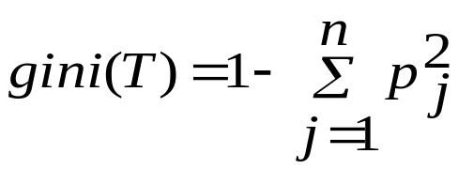
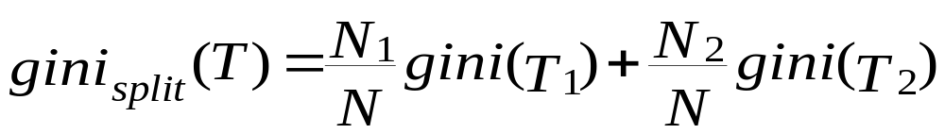
Gini Index (IBM IntelligentMiner)
If a data set T contains examples from n classes, gini index, gini(T) is defined as
where p_{j} is the relative frequency of class j in T.
If a data set T is split into two subsets T₁ and T₂ with sizes N₁ and N₂ respectively, the gini index of the split data contains examples from n classes, the gini index gini(T) is defined as
The attribute provides the smallest gini_{split}(T) is chosen to split the node (need to enumerate all possible splitting points for each attribute).

Slide 14
Approaches to Determine the Final Tree Size
Separate training (2/3) and testing (1/3) sets
Use cross validation, e.g., 10-fold cross validation
Use all the data for training
  but apply a statistical test (e.g., chi-square) to estimate whether expanding or pruning a node may improve the entire distribution
Use minimum description length (MDL) principle:
  halting growth of the tree when the encoding is minimized

Slide 15
Enhancements to basic decision tree induction
Allow for continuous-valued attributes
  Dynamically define new discrete-valued attributes that partition the continuous attribute value into a discrete set of intervals
Handle missing attribute values
  Assign the most common value of the attribute
  Assign probability to each of the possible values
Attribute construction
  Create new attributes based on existing ones that are sparsely represented
  This reduces fragmentation, repetition, and replication

Slide 16
Classification in Large Databases
Classification—a classical problem extensively studied by statisticians and machine learning researchers
Scalability: Classifying data sets with millions of examples and hundreds of attributes with reasonable speed
Why decision tree induction in data mining?
  relatively faster learning speed (than other classification methods)
  convertible to simple and easy to understand classification rules
  can use SQL queries for accessing databases
  comparable classification accuracy with other methods

Slide 17
Scalable Decision Tree Induction
Partition the data into subsets and build a decision tree for each subset?
SLIQ (EDBT’96 — Mehta et al.)
  builds an index for each attribute and only the class list and the current attribute list reside in memory
SPRINT (VLDB’96 — J. Shafer et al.)
  constructs an attribute list data structure
PUBLIC (VLDB’98 — Rastogi & Shim)
  integrates tree splitting and tree pruning: stop growing the tree earlier
RainForest (VLDB’98 — Gehrke, Ramakrishnan & Ganti)
  separates the scalability aspects from the criteria that determine the quality of the tree
  builds an AVC-list (attribute, value, class label)

Slide 18
Data Cube-Based Decision-Tree Induction
Integration of generalization with decision-tree induction (Kamber et al’97).
Classification at primitive concept levels
  E.g., precise temperature, humidity, outlook, etc.
  Low-level concepts, scattered classes, bushy classification-trees
  Semantic interpretation problems.
Cube-based multi-level classification
  Relevance analysis at multi-levels.
  Information-gain analysis with dimension + level.

Slide 19

Presentation of Classification Results

Slide 20
Agenda
What is classification? What is prediction?
Issues regarding classification and prediction
Classification by decision tree induction
Bayesian Classification
Classification by backpropagation
Classification based on concepts from association rule mining
Other Classification Methods
Prediction
Classification accuracy
Summary

Slide 21
Bayesian Classification: Why?
Probabilistic learning:
  Calculate explicit probabilities for hypothesis
  Among the most practical approaches to certain types of learning problems
Incremental:
  Each training example can incrementally increase/decrease the probability that a hypothesis is correct.
  Prior knowledge can be combined with observed data.
Probabilistic prediction:
  Predict multiple hypotheses, weighted by their probabilities
Standard:
  Even when Bayesian methods are computationally intractable, they can provide a standard of optimal decision making against which other methods can be measured

Slide 22
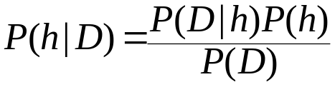
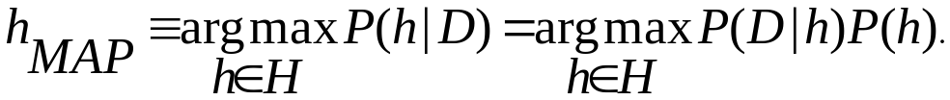
Bayesian Theorem
Given training data D, posteriori probability of a hypothesis h, P(h|D) follows the Bayes theorem
MAP (maximum posteriori) hypothesis
Practical difficulties:
  require initial knowledge of many probabilities
  significant computational cost

Slide 23
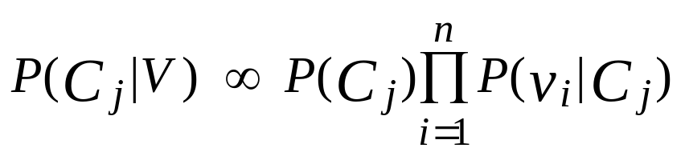
Naïve Bayes Classifier
A simplified assumption: attributes are conditionally independent:
where V are the data samples, v_{i} is the value of attribute i on the sample and C_{j} is the j-th class.
Greatly reduces the computation cost, only count the class distribution.

Slide 24
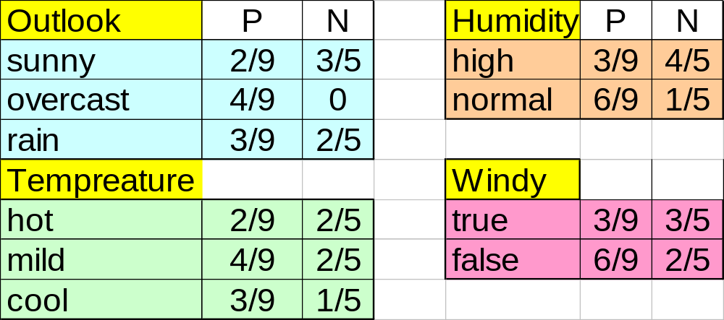
Naive Bayesian Classifier
Given a training set, we can compute the probabilities

Slide 25
Bayesian classification
The classification problem may be formalized using a-posteriori probabilities:
P(C|X) = prob. that the sample tuple X=<x₁,…,x_{k}> is of class C.
E.g. P(class=N | outlook=sunny,windy=true,…)
Idea: assign to sample X the class label C such that P(C|X) is maximal

Slide 26
Estimating a-posteriori probabilities
Bayes theorem:
P(C|X) = P(X|C)·P(C) / P(X)
P(X) is constant for all classes
P(C) = relative freq of class C samples
C such that P(C|X) is maximum =
C such that P(X|C)·P(C) is maximum
Problem: computing P(X|C) is unfeasible!

Slide 27
Naïve Bayesian Classification
Naïve assumption: attribute independence
P(x₁,…,x_{k}|C) = P(x₁|C)·…·P(x_{k}|C)
If i-th attribute is categorical:
P(x_{i}|C) is estimated as the relative freq of samples having value x_{i} as i-th attribute in class C
If i-th attribute is continuous:
P(x_{i}|C) is estimated thru a Gaussian density function
Computationally easy in both cases

Slide 28
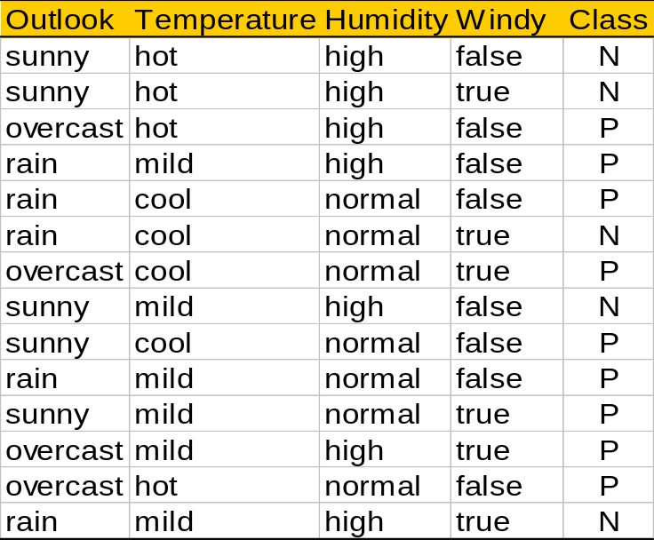
Play-tennis example: estimating P(x_{i}|C)
outlook
P(sunny|p) = 2/9 | P(sunny|n) = 3/5
P(overcast|p) = 4/9 | P(overcast|n) = 0
P(rain|p) = 3/9 | P(rain|n) = 2/5
temperature
P(hot|p) = 2/9 | P(hot|n) = 2/5
P(mild|p) = 4/9 | P(mild|n) = 2/5
P(cool|p) = 3/9 | P(cool|n) = 1/5
humidity
P(high|p) = 3/9 | P(high|n) = 4/5
P(normal|p) = 6/9 | P(normal|n) = 2/5
windy
P(true|p) = 3/9 | P(true|n) = 3/5
P(false|p) = 6/9 | P(false|n) = 2/5
P(p) = 9/14
P(n) = 5/14

Slide 29
Play-tennis example: classifying X
An unseen sample X = <rain, hot, high, false>
P(X|p)·P(p) =
P(rain|p)·P(hot|p)·P(high|p)·P(false|p)·P(p) = 3/9·2/9·3/9·6/9·9/14 = 0.010582
P(X|n)·P(n) =
P(rain|n)·P(hot|n)·P(high|n)·P(false|n)·P(n) = 2/5·2/5·4/5·2/5·5/14 = 0.018286
Sample X is classified in class n (don’t play)

Slide 30
The independence hypothesis…
… makes computation possible
… yields optimal classifiers when satisfied
… but is seldom satisfied in practice, as attributes (variables) are often correlated.
Attempts to overcome this limitation:
  Bayesian networks, that combine Bayesian reasoning with causal relationships between attributes
  Decision trees, that reason on one attribute at a time, considering most important attributes first

Slide 31
Bayesian Belief Networks
Family
History
Smoker
(FH, S)
(FH, ~S)
(~FH, S)
(~FH, ~S)
LC
0.8
0.5
0.7
0.1
LungCancer
Emphysema
~LC
0.2
0.5
0.3
0.9
The conditional probability table for the variable LungCancer
PositiveXRay
Dyspnea
Bayesian Belief Networks

Slide 32
Bayesian Belief Networks
Bayesian belief network allows a subset of the variables conditionally independent
A graphical model of causal relationships
Several cases of learning Bayesian belief networks
  Given both network structure and all the variables: easy
  Given network structure but only some variables
  When the network structure is not known in advance
Classification process returns a prob. distribution for the class label attribute (not just a single class label)

Slide 33
Agenda
What is classification? What is prediction?
Issues regarding classification and prediction
Classification by decision tree induction
Bayesian Classification
Classification by backpropagation
Classification based on concepts from association rule mining
Other Classification Methods
Prediction
Classification accuracy
Summary

Slide 34
Neural Networks
A set of connected input/output units where each connection has
a weight associated with it
Advantages
  prediction accuracy is generally high
  robust, works when training examples contain errors
  output may be discrete, real-valued, or a vector of several discrete or real-valued attributes
  fast evaluation of the learned target function
Criticism
  long training time
  require (typically empirically determined) parameters (e.g. network topology)
  difficult to understand the learned function (weights)
  not easy to incorporate domain knowledge

Slide 35
A Neuron
-
μ_{k}
x₀
w₀
x₁
w₁
∑
f
output y
x_{n}
w_{n}
Input
vector x
weight
vector w
weighted
sum
Activation
function
The n-dimensional input vector x is mapped into variable y by means of the scalar product and a nonlinear function mapping

Slide 36
Network Training
The ultimate objective of training
  obtain a set of weights that makes almost all the tuples in the training data classified correctly
Steps
  Initialize weights with random values
  Feed the input tuples into the network one by one
  For each unit
    Compute the net input to the unit as a linear combination of all the inputs to the unit
    Compute the output value using the activation function
    Compute the error
    Update the weights and the bias

Slide 37




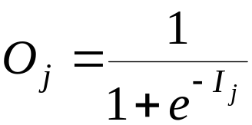
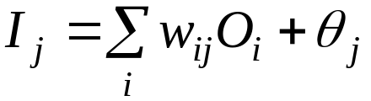
Multi-Layer Perceptron
Output vector
Output nodes
Hidden nodes
w_{ij}
Input nodes
Input vector: x_{i}

Slide 38
Network Pruning and Rule Extraction
Network pruning
  Fully connected network will be hard to articulate
  N input nodes, h hidden nodes and m output nodes lead to h(m+N) weights
  Pruning: Remove some of the links without affecting classification accuracy of the network
Extracting rules from a trained network
  Discretize activation values; replace individual activation value by the cluster average maintaining the network accuracy
  Enumerate the output from the discretized activation values to find rules between activation value and output
  Find the relationship between the input and activation value
  Combine the above two to have rules relating the output to input
Perform sensitivity analysis
  Assess the impact of a given input variable on the output

Slide 39
Agenda
What is classification? What is prediction?
Issues regarding classification and prediction
Classification by decision tree induction
Bayesian Classification
Classification by backpropagation
Support Vector Machines
Classification based on concepts from association rule mining
Other Classification Methods
Prediction
Classification accuracy
Summary

Slide 40
SVM—Support Vector Machines
A new classification method for both linear and nonlinear data
It uses a nonlinear mapping to transform the original training data into a higher dimension
With the new dimension, it searches for the linear optimal separating hyperplane (i.e., “decision boundary”)
With an appropriate nonlinear mapping to a sufficiently high dimension, data from two classes can always be separated by a hyperplane
SVM finds this hyperplane using support vectors (“essential” training tuples) and margins (defined by the support vectors)

Slide 41
SVM—History and Applications
Vapnik and colleagues (1992)—groundwork from Vapnik & Chervonenkis’ statistical learning theory in 1960s
Features: training can be slow but accuracy is high owing to their ability to model complex nonlinear decision boundaries (margin maximization)
Used both for classification and prediction
Applications:
  handwritten digit recognition, object recognition, speaker identification, benchmarking time-series prediction tests

Slide 42
SVM—General Philosophy
Small Margin
Large Margin
Support Vectors

Slide 43


SVM—Margins and Support Vectors

Slide 44
SVM—When Data Is Linearly Separable
m
Let data D be (X₁, y₁), …, (X_{|D|}, y_{|D|}), where X_{i} is the set of training tuples associated with the class labels y_{i}
There are infinite lines (hyperplanes) separating the two classes but we want to find the best one (the one that minimizes classification error on unseen data)
SVM searches for the hyperplane with the largest margin, i.e., maximum marginal hyperplane (MMH)

Slide 45
SVM—Linearly Separable
A separating hyperplane can be written as
    W ● X + b = 0
  where W={w₁, w₂, …, w_{n}} is a weight vector and b a scalar (bias)
For 2-D it can be written as
    w₀ + w₁ x₁ + w₂ x₂ = 0
The hyperplane defining the sides of the margin:
    H₁: w₀ + w₁ x₁ + w₂ x₂ ≥ 1 for y_{i} = +1, and
    H₂: w₀ + w₁ x₁ + w₂ x₂ ≤ – 1 for y_{i} = –1
Any training tuples that fall on hyperplanes H₁ or H₂ (i.e., the
sides defining the margin) are support vectors
This becomes a constrained (convex) quadratic optimization problem: Quadratic objective function and linear constraints → Quadratic Programming (QP) → Lagrangian multipliers

Slide 46
Why Is SVM Effective on High Dimensional Data?
The complexity of trained classifier is characterized by the # of support vectors rather than the dimensionality of the data
The support vectors are the essential or critical training examples —they lie closest to the decision boundary (MMH)
If all other training examples are removed and the training is repeated, the same separating hyperplane would be found
The number of support vectors found can be used to compute an (upper) bound on the expected error rate of the SVM classifier, which is independent of the data dimensionality
Thus, an SVM with a small number of support vectors can have good generalization, even when the dimensionality of the data is high

Slide 47


SVM—Linearly Inseparable
Transform the original input data into a higher dimensional space
Search for a linear separating hyperplane in the new space

Slide 48
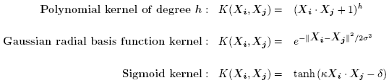
SVM—Kernel functions
Instead of computing the dot product on the transformed data tuples, it is mathematically equivalent to instead applying a kernel function K(X_{i}, X_{j}) to the original data, i.e., K(X_{i}, X_{j}) = Φ(X_{i}) Φ(X_{j})
Typical Kernel Functions
SVM can also be used for classifying multiple (> 2) classes and for regression analysis (with additional user parameters)

Slide 49
Scaling SVM by Hierarchical MicroClustering
SVM is not scalable to the number of data objects in terms of training time and memory usage
“Classifying Large Datasets Using SVMs with Hierarchical Clusters Problem” by Hwanjo Yu, Jiong Yang, Jiawei Han, KDD’03
CB-SVM (Clustering-Based SVM)
  Given limited amount of system resources (e.g., memory), maximize the SVM performance in terms of accuracy and the training speed
  Use micro-clustering to effectively reduce the number of points to be considered
  At deriving support vectors, de-cluster micro-clusters near “candidate vector” to ensure high classification accuracy

Slide 50
CB-SVM: Clustering-Based SVM
Training data sets may not even fit in memory
Read the data set once (minimizing disk access)
  Construct a statistical summary of the data (i.e., hierarchical clusters) given a limited amount of memory
  The statistical summary maximizes the benefit of learning SVM
The summary plays a role in indexing SVMs
Essence of Micro-clustering (Hierarchical indexing structure)
  Use micro-cluster hierarchical indexing structure
    provide finer samples closer to the boundary and coarser samples farther from the boundary
  Selective de-clustering to ensure high accuracy

Slide 51
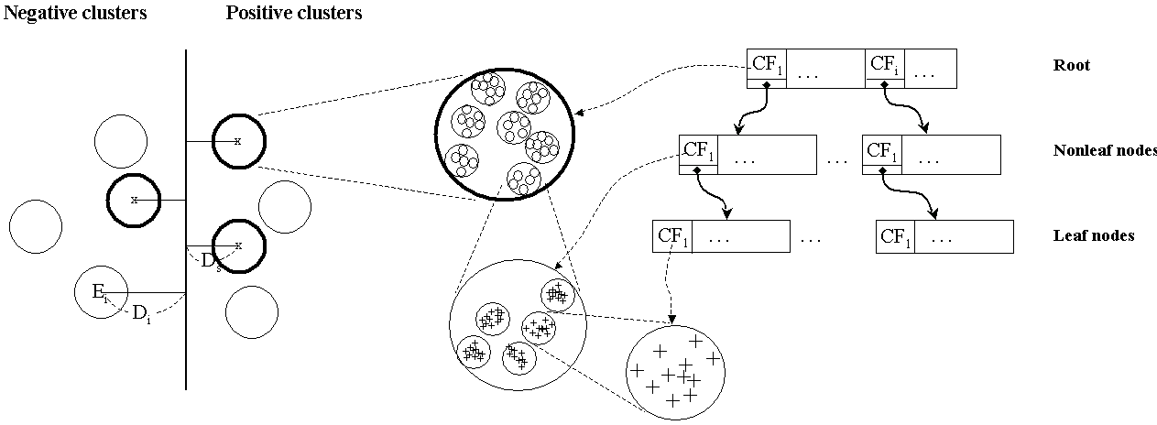
CF-Tree: Hierarchical Micro-cluster

Slide 52
CB-SVM Algorithm: Outline
Construct two CF-trees from positive and negative data sets independently
  Need one scan of the data set
Train an SVM from the centroids of the root entries
De-cluster the entries near the boundary into the next level
  The children entries de-clustered from the parent entries are accumulated into the training set with the non-declustered parent entries
Train an SVM again from the centroids of the entries in the training set
Repeat until nothing is accumulated

Slide 53
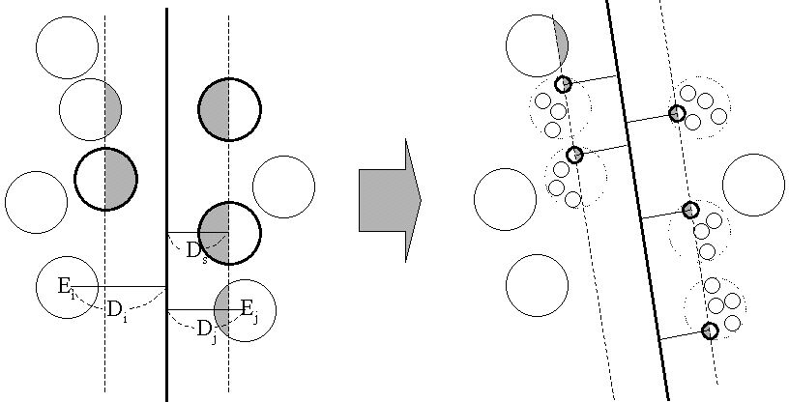
Selective Declustering
CF tree is a suitable base structure for selective declustering
De-cluster only the cluster E_{i} such that
  D_{i} – R_{i} < D_{s}, where D_{i} is the distance from the boundary to the center point of E_{i} and R_{i} is the radius of E_{i}
  Decluster only the cluster whose subclusters have possibilities to be the support cluster of the boundary
    “Support cluster”: The cluster whose centroid is a support vector

Slide 54
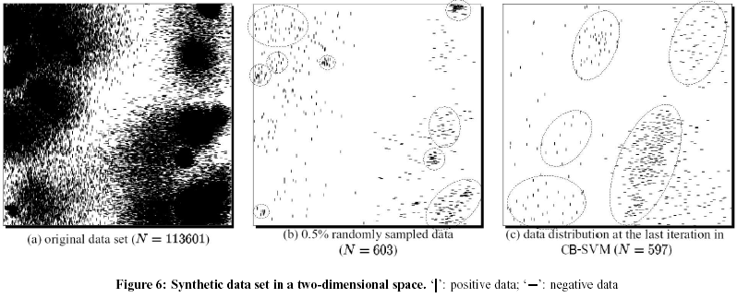
Experiment on Synthetic Dataset

Slide 55
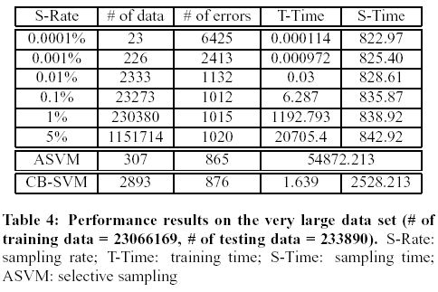
Experiment on a Large Data Set

Slide 56
SVM vs. Neural Network
SVM
  Relatively new concept
  Deterministic algorithm
  Nice Generalization properties
  Hard to learn – learned in batch mode using quadratic programming techniques
  Using kernels can learn very complex functions
Neural Network
  Relatively old
  Nondeterministic algorithm
  Generalizes well but doesn’t have strong mathematical foundation
  Can easily be learned in incremental fashion
  To learn complex functions—use multilayer perceptron (not that trivial)

Slide 57
SVM Related Links
SVM Website
  http://www.kernel-machines.org/
Representative implementations
  LIBSVM: an efficient implementation of SVM, multi-class classifications, nu-SVM, one-class SVM, including also various interfaces with java, python, etc.
  SVM-light: simpler but performance is not better than LIBSVM, support only binary classification and only C language
  SVM-torch: another recent implementation also written in C.

Slide 58
SVM—Introduction Literature
“Statistical Learning Theory” by Vapnik: extremely hard to understand, containing many errors too.
C. J. C. Burges. A Tutorial on Support Vector Machines for Pattern Recognition. Knowledge Discovery and Data Mining, 2(2), 1998.
  Better than the Vapnik’s book, but still written too hard for introduction, and the examples are so not-intuitive
The book “An Introduction to Support Vector Machines” by N. Cristianini and J. Shawe-Taylor
  Also written hard for introduction, but the explanation about the mercer’s theorem is better than above literatures
The neural network book by Haykins
  Contains one nice chapter of SVM introduction

Slide 59
Agenda
What is classification? What is prediction?
Issues regarding classification and prediction
Classification by decision tree induction
Bayesian Classification
Classification by backpropagation
Support Vector Machines
Classification based on concepts from association rule mining
Other Classification Methods
Prediction
Classification accuracy
Summary

Slide 60
Association-Based Classification
Several methods for association-based classification
  ARCS: Quantitative association mining and clustering of association rules (Lent et al’97)
    It beats C4.5 in (mainly) scalability and also accuracy
  Associative classification: (Liu et al’98)
    It mines high support and high confidence rules in the form of “cond_set => y”, where y is a class label
  CAEP (Classification by aggregating emerging patterns) (Dong et al’99)
    Emerging patterns (EPs): the itemsets whose support increases significantly from one class to another
    Mine Eps based on minimum support and growth rate

Slide 61
Agenda
What is classification? What is prediction?
Issues regarding classification and prediction
Classification by decision tree induction
Bayesian Classification
Classification by backpropagation
Classification based on concepts from association rule mining
Other Classification Methods
Prediction
Classification accuracy
Summary

Slide 62
Other Classification Methods
k-nearest neighbor classifier
case-based reasoning
Genetic algorithm
Rough set approach
Fuzzy set approaches

Slide 63
Instance-Based Methods
Instance-based learning (or learning by ANALOGY):
  Store training examples and delay the processing (“lazy evaluation”) until a new instance must be classified
Typical approaches
  k-nearest neighbor approach
    Instances represented as points in a Euclidean space.
  Locally weighted regression
    Constructs local approximation
  Case-based reasoning
    Uses symbolic representations and knowledge-based inference

Slide 64
The k-Nearest Neighbor Algorithm
All instances correspond to points in the n-D space.
The nearest neighbors are defined in terms of Euclidean distance.
The target function could be discrete- or real- valued.
For discrete-valued, the k-NN returns the most common value among the k training examples nearest to xq.
Vonoroi diagram: the decision surface induced by 1-NN for a typical set of training examples.
_
.
_
_
.
+
_
.
+
.
.
_
xq
+
_
.
+

Slide 65
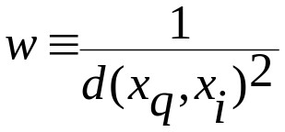
Discussion on the k-NN Algorithm
The k-NN algorithm for continuous-valued target functions
  Calculate the mean values of the k nearest neighbors
Distance-weighted nearest neighbor algorithm
  Weight the contribution of each of the k neighbors according to their distance to the query point x_{q}
    giving greater weight to closer neighbors
  Similarly, for real-valued target functions
Robust to noisy data by averaging k-nearest neighbors
Curse of dimensionality: distance between neighbors could be dominated by irrelevant attributes.
  To overcome it, axes stretch or elimination of the least relevant attributes.

Slide 66
Case-Based Reasoning
Also uses: lazy evaluation + analyze similar instances
Difference: Instances are not “points in a Euclidean space”
Example: Water faucet problem in CADET (Sycara et al’92)
Methodology
  Instances represented by rich symbolic descriptions (e.g., function graphs)
  Multiple retrieved cases may be combined
  Tight coupling between case retrieval, knowledge-based reasoning, and problem solving
Research issues
  Indexing based on syntactic similarity measure, and when failure, backtracking, and adapting to additional cases

Slide 67
Remarks on Lazy vs. Eager Learning
Instance-based learning: lazy evaluation
Decision-tree and Bayesian classification: eager evaluation
Key differences
  Lazy method may consider query instance xq when deciding how to generalize beyond the training data D
  Eager method cannot since they have already chosen global approximation when seeing the query
Efficiency: Lazy - less time training but more time predicting
Accuracy
  Lazy method effectively uses a richer hypothesis space since it uses many local linear functions to form its implicit global approximation to the target function
  Eager: must commit to a single hypothesis that covers the entire instance space

Slide 68
Genetic Algorithms – Evolutionary Approach
GA: based on an analogy to biological evolution
Each rule is represented by a string of bits
An initial population is created consisting of randomly generated rules
  e.g., IF A₁ and Not A₂ then C₂ can be encoded as 100
Based on the notion of survival of the fittest, a new population is formed to consists of the fittest rules and their offsprings
The fitness of a rule is represented by its classification accuracy on a set of training examples
Offsprings are generated by crossover and mutation

Slide 69

Rough Set Approach
Rough sets are used to approximately or “roughly” define equivalent classes (applied to discrete-valued attributes)
A rough set for a given class C is approximated by two sets: a lower approximation (certain to be in C) and an upper approximation (cannot be described as not belonging to C)
Also used for feature reduction: Finding the minimal subsets (reducts) of attributes (for feature reduction) is NP-hard but a discernibility matrix (that stores differences between attribute values for each pair of samples) is used to reduce the computation intensity

Slide 70

Fuzzy Set Approaches
Fuzzy logic uses truth values between 0.0 and 1.0 to represent the degree of membership (such as using fuzzy membership graph)
Attribute values are converted to fuzzy values
  e.g., income is mapped into the discrete categories {low, medium, high} with fuzzy values calculated
For a given new sample, more than one fuzzy value may apply
Each applicable rule contributes a vote for membership in the categories
Typically, the truth values for each predicted category are summed

Slide 71
Agenda
What is classification? What is prediction?
Issues regarding classification and prediction
Classification by decision tree induction
Bayesian Classification
Classification by backpropagation
Classification based on concepts from association rule mining
Other Classification Methods
Prediction
Classification accuracy
Summary

Slide 72
What Is Prediction?
Prediction is similar to classification
  First, construct a model
  Second, use model to predict unknown value
    Major method for prediction is regression
      Linear and multiple regression
      Non-linear regression
Prediction is different from classification
  Classification refers to predict categorical class label
  Prediction models continuous-valued functions

Slide 73
Predictive Modeling in Databases
Predictive modeling:
  Predict data values or construct generalized linear models based on the database data.
  predict value ranges or category distributions
Method outline:
  Minimal generalization
  Attribute relevance analysis
  Generalized linear model construction
  Prediction
Determine the major factors which influence the prediction
  Data relevance analysis: uncertainty measurement, entropy analysis, expert judgement, etc.
Multi-level prediction: drill-down and roll-up analysis

Slide 74
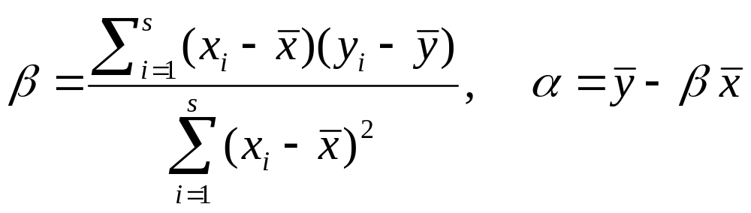
Regress Analysis and Log-Linear Models in Prediction
Linear regression: Y = α + β X
  Two parameters , α and β specify the (Y-intercept and slope of the) line and are to be estimated by using the data at hand.
  using the least squares criterion to the known values of (X1,Y1), (X2,Y2), …, (Xs,Ys)

Slide 75
Regress Analysis and Log-Linear Models in Prediction
Multiple regression: Y = a + b1 X1 + b2 X2.
  More than one predictor variable
  Many nonlinear functions can be transformed into the above.
Nonlinear regression: Y = a + b1 X + b2 X² + b3 X³.
Log-linear models:
  They approximate discrete multidimensional probability distributions (multi-way table of joint probabilities) by a product of lower-order tables.
  Probability: p(a, b, c, d) = αab βacχad δbcd

Slide 76

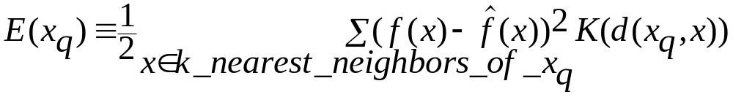
Locally Weighted Regression
Construct an explicit approximation to f over a local region surrounding query instance xq.
Locally weighted linear regression:
  The target function f is approximated near xq using the linear function:
  minimize the squared error: distance-decreasing weight K
  the gradient descent training rule:
In most cases, the target function is approximated by a constant, linear, or quadratic function.

Slide 77
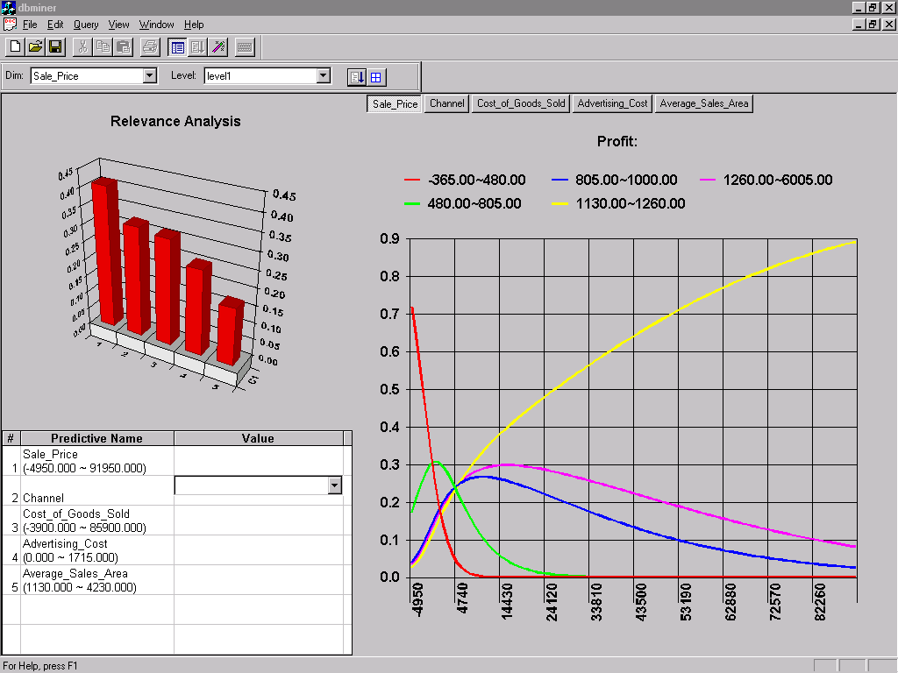
Prediction: Numerical Data

Slide 78
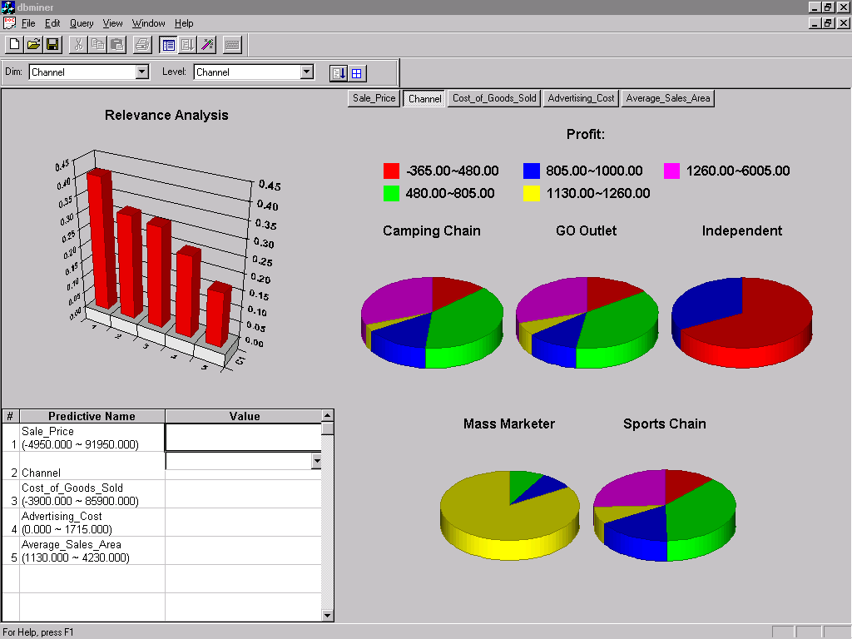
Prediction: Categorical Data

Slide 79
Agenda
What is classification? What is prediction?
Issues regarding classification and prediction
Classification by decision tree induction
Bayesian Classification
Classification by backpropagation
Classification based on concepts from association rule mining
Other Classification Methods
Prediction
Classification accuracy
Summary

Slide 80
Classifier Accuracy Measures
 | C₁ | C₂
C₁ | True positive | False negative
C₂ | False positive | True negative
classes | buy_computer = yes | buy_computer = no | total | recognition(%)
buy_computer = yes | 6954 | 46 | 7000 | 99.34
buy_computer = no | 412 | 2588 | 3000 | 86.27
total | 7366 | 2634 | 10000 | 95.52
Accuracy of a classifier M, acc(M): percentage of test set tuples that are correctly classified by the model M
  Error rate (misclassification rate) of M = 1 – acc(M)
  Given m classes, CM_{i,j}, an entry in a confusion matrix, indicates # of tuples in class i that are labeled by the classifier as class j
Alternative accuracy measures (e.g., for cancer diagnosis)
  sensitivity = t-pos/pos /* true positive recognition rate */
  specificity = t-neg/neg /* true negative recognition rate */
  precision = t-pos/(t-pos + f-pos)
  accuracy = sensitivity * pos/(pos + neg) + specificity * neg/(pos + neg)
  This model can also be used for cost-benefit analysis

Slide 81



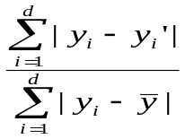
Predictor Error Measures
Measure predictor accuracy: measure how far off the predicted value is from the actual known value
Loss function: measures the error betw. y_{i} and the predicted value y_{i}’
  Absolute error: | y_{i} – y_{i}’|
  Squared error: (y_{i} – y_{i}’)²
Test error (generalization error): the average loss over the test set
  Mean absolute error: Mean squared error:
  Relative absolute error: Relative squared error:
  The mean squared-error exaggerates the presence of outliers
  Popularly use (square) root mean-square error, similarly, root relative squared error

Slide 82
Evaluating the Accuracy of a Classifier or Predictor (I)
Holdout method
  Given data is randomly partitioned into two independent sets
    Training set (e.g., 2/3) for model construction
    Test set (e.g., 1/3) for accuracy estimation
  Random sampling: a variation of holdout
    Repeat holdout k times, accuracy = avg. of the accuracies obtained
Cross-validation (k-fold, where k = 10 is most popular)
  Randomly partition the data into k mutually exclusive subsets, each approximately equal size
  At i-th iteration, use D_{i} as test set and others as training set
  Leave-one-out: k folds where k = # of tuples, for small sized data
  Stratified cross-validation: folds are stratified so that class dist. in each fold is approx. the same as that in the initial data

Slide 83
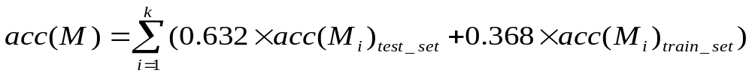
Evaluating the Accuracy of a Classifier or Predictor (II)
Bootstrap
  Works well with small data sets
  Samples the given training tuples uniformly with replacement
    i.e., each time a tuple is selected, it is equally likely to be selected again and re-added to the training set
Several boostrap methods, and a common one is .632 boostrap
  Suppose we are given a data set of d tuples. The data set is sampled d times, with replacement, resulting in a training set of d samples. The data tuples that did not make it into the training set end up forming the test set. About 63.2% of the original data will end up in the bootstrap, and the remaining 36.8% will form the test set (since (1 – 1/d)^{d} ≈ e⁻¹ = 0.368)
  Repeat the sampling procedue k times, overall accuracy of the model:

Slide 84
Agenda
What is classification? What is prediction?
Issues regarding classification and prediction
Classification by decision tree induction
Bayesian Classification
Classification by backpropagation
Classification based on concepts from association rule mining
Other Classification Methods
Prediction
Classification accuracy
Ensemble methods, Bagging, Boosting
Summary

Slide 85

Ensemble Methods: Increasing the Accuracy
Ensemble methods
  Use a combination of models to increase accuracy
  Combine a series of k learned models, M₁, M₂, …, M_{k}, with the aim of creating an improved model M*
Popular ensemble methods
  Bagging: averaging the prediction over a collection of classifiers
  Boosting: weighted vote with a collection of classifiers
  Ensemble: combining a set of heterogeneous classifiers

Slide 86
Bagging: Boostrap Aggregation
Analogy: Diagnosis based on multiple doctors’ majority vote
Training
  Given a set D of d tuples, at each iteration i, a training set D_{i} of d tuples is sampled with replacement from D (i.e., boostrap)
  A classifier model M_{i} is learned for each training set D_{i}
Classification: classify an unknown sample X
  Each classifier M_{i} returns its class prediction
  The bagged classifier M* counts the votes and assigns the class with the most votes to X
Prediction: can be applied to the prediction of continuous values by taking the average value of each prediction for a given test tuple
Accuracy
  Often significant better than a single classifier derived from D
  For noise data: not considerably worse, more robust
  Proved improved accuracy in prediction

Slide 87
Boosting
Analogy: Consult several doctors, based on a combination of weighted diagnoses—weight assigned based on the previous diagnosis accuracy
How boosting works?
  Weights are assigned to each training tuple
  A series of k classifiers is iteratively learned
  After a classifier M_{i} is learned, the weights are updated to allow the subsequent classifier, M_{i+1}, to pay more attention to the training tuples that were misclassified by M_{i}
  The final M* combines the votes of each individual classifier, where the weight of each classifier's vote is a function of its accuracy
The boosting algorithm can be extended for the prediction of continuous values
Comparing with bagging: boosting tends to achieve greater accuracy, but it also risks overfitting the model to misclassified data

Slide 88
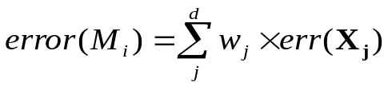
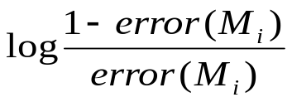
Adaboost (Freund and Schapire, 1997)
Given a set of d class-labeled tuples, (X₁, y₁), …, (X_{d}, y_{d})
Initially, all the weights of tuples are set the same (1/d)
Generate k classifiers in k rounds. At round i,
  Tuples from D are sampled (with replacement) to form a training set D_{i} of the same size
  Each tuple’s chance of being selected is based on its weight
  A classification model M_{i} is derived from D_{i}
  Its error rate is calculated using D_{i} as a test set
  If a tuple is misclassified, its weight is increased, o.w. it is decreased
Error rate: err(X_{j}) is the misclassification error of tuple X_{j}. Classifier M_{i} error rate is the sum of the weights of the misclassified tuples:
The weight of classifier M_{i}’s vote is

Slide 89

Model Selection: ROC Curves
ROC (Receiver Operating Characteristics) curves: for visual comparison of classification models
Originated from signal detection theory
Shows the trade-off between the true positive rate and the false positive rate
The area under the ROC curve is a measure of the accuracy of the model
Rank the test tuples in decreasing order: the one that is most likely to belong to the positive class appears at the top of the list
The closer to the diagonal line (i.e., the closer the area is to 0.5), the less accurate is the model
Vertical axis: true positive rate
Horizontal axis: false positive rate
Diagonal line?
A model with perfect accuracy: area of 1.0

Slide 90
Agenda
What is classification? What is prediction?
Issues regarding classification and prediction
Classification by decision tree induction
Bayesian Classification
Classification by backpropagation
Classification based on concepts from association rule mining
Other Classification Methods
Prediction
Classification accuracy
Summary

Slide 91
Summary (I)
Classification and prediction are two forms of data analysis that can be used to extract models describing important data classes or to predict future data trends.
Effective and scalable methods have been developed for decision trees induction, Naive Bayesian classification, Bayesian belief network, rule-based classifier, Backpropagation, Support Vector Machine (SVM), associative classification, nearest neighbor classifiers, and case-based reasoning, and other classification methods such as genetic algorithms, rough set and fuzzy set approaches.
Linear, nonlinear, and generalized linear models of regression can be used for prediction. Many nonlinear problems can be converted to linear problems by performing transformations on the predictor variables. Regression trees and model trees are also used for prediction.

Slide 92
Summary (II)
Stratified k-fold cross-validation is a recommended method for accuracy estimation. Bagging and boosting can be used to increase overall accuracy by learning and combining a series of individual models.
Significance tests and ROC curves are useful for model selection
There have been numerous comparisons of the different classification and prediction methods, and the matter remains a research topic
No single method has been found to be superior over all others for all data sets
Issues such as accuracy, training time, robustness, interpretability, and scalability must be considered and can involve trade-offs, further complicating the quest for an overall superior method

Slide 93
References (1)
C. Apte and S. Weiss. Data mining with decision trees and decision rules. Future Generation Computer Systems, 13, 1997.
C. M. Bishop, Neural Networks for Pattern Recognition. Oxford University Press, 1995.
L. Breiman, J. Friedman, R. Olshen, and C. Stone. Classification and Regression Trees. Wadsworth International Group, 1984.
C. J. C. Burges. A Tutorial on Support Vector Machines for Pattern Recognition. Data Mining and Knowledge Discovery, 2(2): 121-168, 1998.
P. K. Chan and S. J. Stolfo. Learning arbiter and combiner trees from partitioned data for scaling machine learning. KDD'95.
W. Cohen. Fast effective rule induction. ICML'95.
G. Cong, K.-L. Tan, A. K. H. Tung, and X. Xu. Mining top-k covering rule groups for gene expression data. SIGMOD'05.
A. J. Dobson. An Introduction to Generalized Linear Models. Chapman and Hall, 1990.
G. Dong and J. Li. Efficient mining of emerging patterns: Discovering trends and differences. KDD'99.
R. O. Duda, P. E. Hart, and D. G. Stork. Pattern Classification, 2ed. John Wiley and Sons, 2001
U. M. Fayyad. Branching on attribute values in decision tree generation. AAAI’94.
Y. Freund and R. E. Schapire. A decision-theoretic generalization of on-line learning and an application to boosting. J. Computer and System Sciences, 1997.
J. Gehrke, R. Ramakrishnan, and V. Ganti. Rainforest: A framework for fast decision tree construction of large datasets. VLDB’98.
J. Gehrke, V. Gant, R. Ramakrishnan, and W.-Y. Loh, BOAT -- Optimistic Decision Tree Construction. SIGMOD'99.
T. Hastie, R. Tibshirani, and J. Friedman. The Elements of Statistical Learning: Data Mining, Inference, and Prediction. Springer-Verlag, 2001.
D. Heckerman, D. Geiger, and D. M. Chickering. Learning Bayesian networks: The combination of knowledge and statistical data. Machine Learning, 1995.
M. Kamber, L. Winstone, W. Gong, S. Cheng, and J. Han. Generalization and decision tree induction: Efficient classification in data mining. RIDE'97.
B. Liu, W. Hsu, and Y. Ma. Integrating Classification and Association Rule. KDD'98.
W. Li, J. Han, and J. Pei, CMAR: Accurate and Efficient Classification Based on Multiple Class-Association Rules, ICDM'01.

Slide 94
References (2)
T.-S. Lim, W.-Y. Loh, and Y.-S. Shih. A comparison of prediction accuracy, complexity, and training time of thirty-three old and new classification algorithms. Machine Learning, 2000.
J. Magidson. The Chaid approach to segmentation modeling: Chi-squared automatic interaction detection. In R. P. Bagozzi, editor, Advanced Methods of Marketing Research, Blackwell Business, 1994.
M. Mehta, R. Agrawal, and J. Rissanen. SLIQ : A fast scalable classifier for data mining. EDBT'96.
T. M. Mitchell. Machine Learning. McGraw Hill, 1997.
S. K. Murthy, Automatic Construction of Decision Trees from Data: A Multi-Disciplinary Survey, Data Mining and Knowledge Discovery 2(4): 345-389, 1998
J. R. Quinlan. Induction of decision trees. Machine Learning, 1:81-106, 1986.
J. R. Quinlan and R. M. Cameron-Jones. FOIL: A midterm report. ECML’93.
J. R. Quinlan. C4.5: Programs for Machine Learning. Morgan Kaufmann, 1993.
J. R. Quinlan. Bagging, boosting, and c4.5. AAAI'96.
R. Rastogi and K. Shim. Public: A decision tree classifier that integrates building and pruning. VLDB’98.
J. Shafer, R. Agrawal, and M. Mehta. SPRINT : A scalable parallel classifier for data mining. VLDB’96.
J. W. Shavlik and T. G. Dietterich. Readings in Machine Learning. Morgan Kaufmann, 1990.
P. Tan, M. Steinbach, and V. Kumar. Introduction to Data Mining. Addison Wesley, 2005.
S. M. Weiss and C. A. Kulikowski. Computer Systems that Learn: Classification and Prediction Methods from Statistics, Neural Nets, Machine Learning, and Expert Systems. Morgan Kaufman, 1991.
S. M. Weiss and N. Indurkhya. Predictive Data Mining. Morgan Kaufmann, 1997.
I. H. Witten and E. Frank. Data Mining: Practical Machine Learning Tools and Techniques, 2ed. Morgan Kaufmann, 2005.
X. Yin and J. Han. CPAR: Classification based on predictive association rules. SDM'03
H. Yu, J. Yang, and J. Han. Classifying large data sets using SVM with hierarchical clusters. KDD'03.

Slide 95


